Slide 1

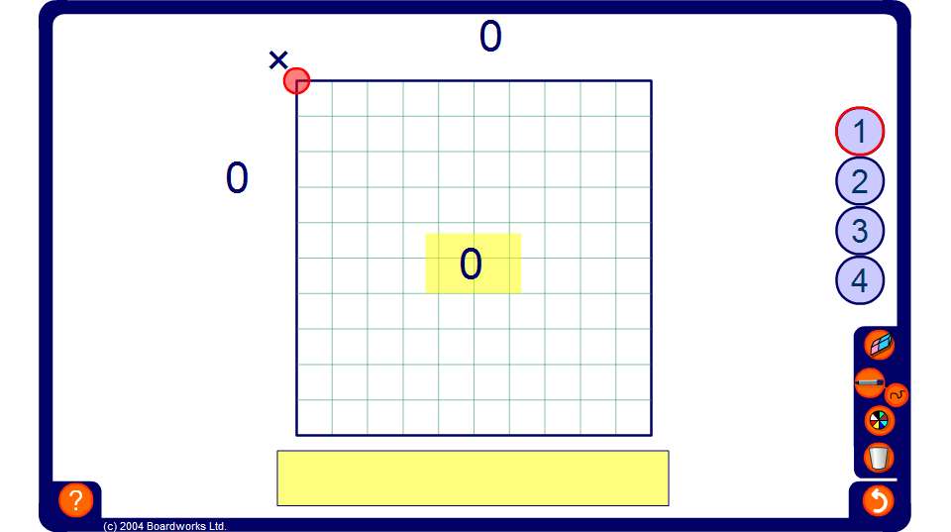


Multiplying by small multiples of 0.1
Notes:
Use this grid to demonstrate the effect of multiplying by 0.1 and small multiples of 0.1.
Start by explaining to pupils that the large square represents one whole. It is one unit across and one unit down. The square is divided into ten equal parts across the top and so each division across the length must be equal to 0.1. The same is true down the side. Establish that the unit square is divided into 100 equal parts and so each small part is one hundredth of the large square or 0.01.
Compare this with the fact that there are 100 mm² in 1 cm².
Demonstrate various calculations by changing the size of the shaded area. For example, start by showing that 0.1 × 0.1 = 0.01. One tenth of the width multiplied by one tenth of the length equals one hundredth of the whole unit.
Ask pupils what 0.2 × 0.4 is equal to. It is a common error to give the answer as 0.8. Show, using the grid that the answer is 0.08.
Change the number of unit squares to extend to more difficult problems. For example, 0.4 × 3.7 is equal to 0.4 × (1 + 1 + 1 + 0.7) = 0.4 + 0.4 + 0.4 + 0.28 = 1.48
Click on the yellow rectangles to hide the answers. An ask pupils to calculate the solutions mentally using the diagram.

